Slide 1
Java 4 WEB
Lesson 13 - Home Task Overview

Slide 2
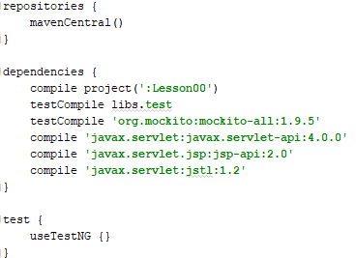
1. Use correct dependency scope

Slide 3
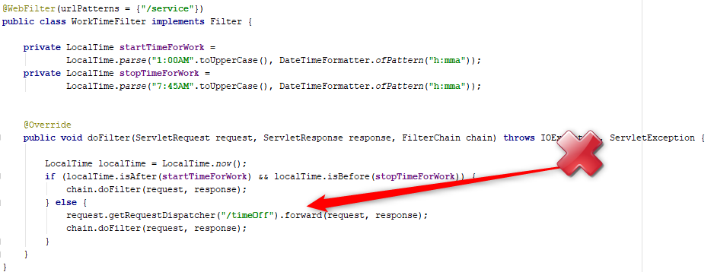
2. Filter doesn’t know about error processing
Notes:
Filter should not know about error processing
Name time var more descriptive
Parsing of constant data is a code smell
Do not invoke pass filter chain when error happens
Use static modifier for constants
Process any request

Slide 4
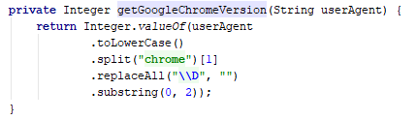
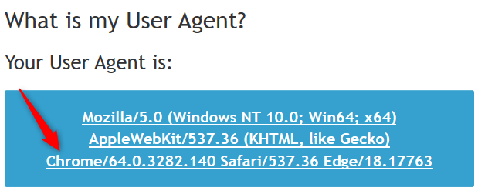
3. Incorrect user agent detection

Slide 5
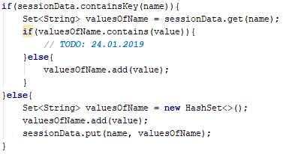
4. Add more details in TODO comments

Slide 6
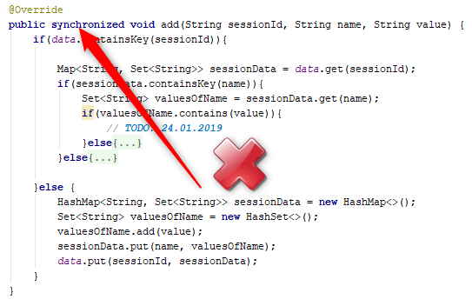
5. Tomcat is responsible for concurrency

Slide 7
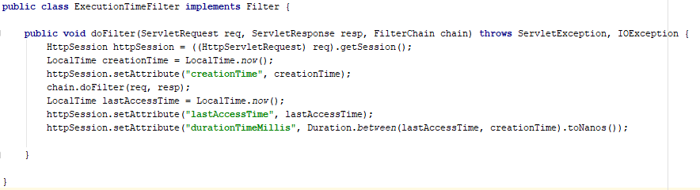
6. KISS
Notes:
Filter will work incorrectly if request started today and finished tomorrow.
Do not add extra attribute into session, if needed use least possible scope i.e. – request scope

Slide 8
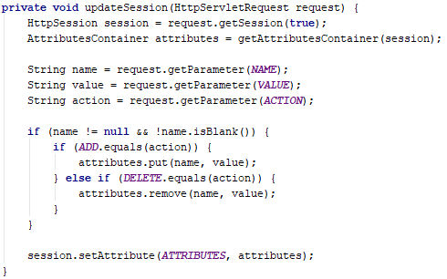
8. Follow Open-Close principle
Notes:
Use polymorphism and static factory pattern

Slide 9
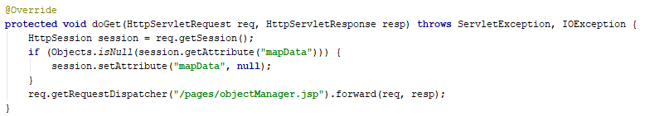
7. Be logic
Notes:
If null set null?

Slide 10
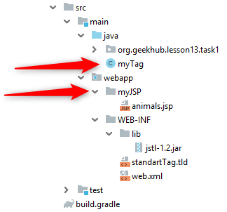
8. Follow convention

Slide 11
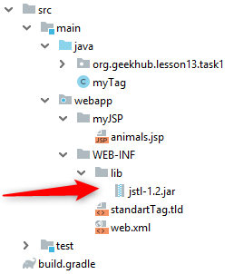
9. Automate dependency management

Slide 12
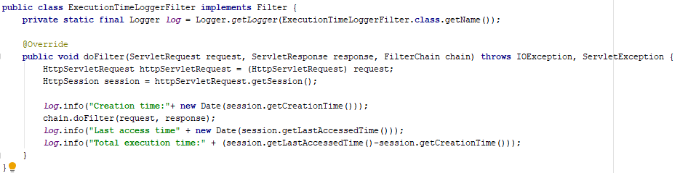
10. Request time is logged incorrectly
Notes:
When exception will be thrown in chained filter, finish time will not be printed
Use more actual DateTime API introduced in java 8
Measure request time but not a session info

Slide 13

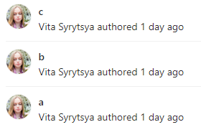










*. Follow VCS conventions
Notes:
Become older. Specify user name.
Are you joker? Be serious in commit messages (are you going to work with low-level project entire life)
Use naming related to domain but not current mood or situation
Are you dynasty man?
Specify reason for any changes (add reference to related task)
Add some comment for made changes
Use lesson letter in task name (what was changed?)
Follow single responsibility also for commits (make commits revertable). Check text be translator
Do we have separation for good and bad tests?
Do not commit every file separately. How will you revert them? Program should work after every commit
What was changed in commits?
Specify solved task in commit message

